Slide 1
Unvilling Marketing
1. Introduction
overview:
The fact is, the traditional lines of marketing are starting to blur as it increasingly crosses the line into informing product development and research. Customer care and service is blending with marketing through social media engagement. Even the role of IT is shifting, as leading Gartner analyst Laura McLellan recently predicted that by 2017 CMOs will spend more on technology than CIOs.
Purpose:
The key words in this definition are; systematic, objective and analysis. Marketing research seeks to set about its task in a systematic and objective fashion. This means that a detailed

Slide 2
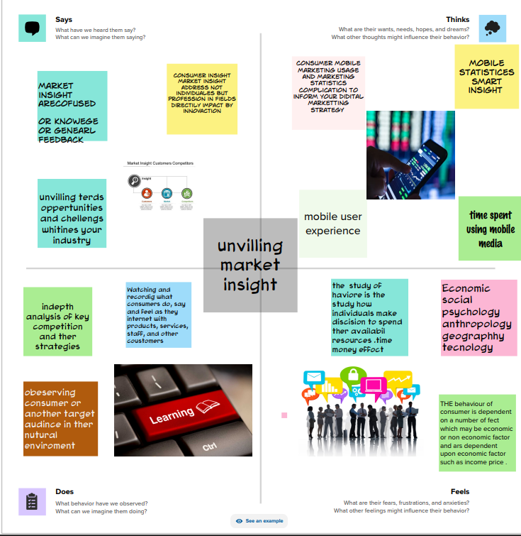
and carefully designed research plan is developed in which each stage of the research is specified. Such a research plan is only considered adequate if it specifies: the research problem in concise and precise terms, the information necessary to address the problem, the methods to be employed in gathering the information and the analytical techniques to be used to interpret it.
2. problem Definition and Design Thinking:
Empathy Map:

Slide 3
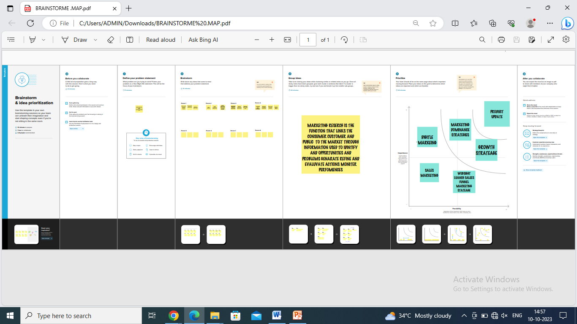
Ideation & Brainstorming Map:

Slide 4
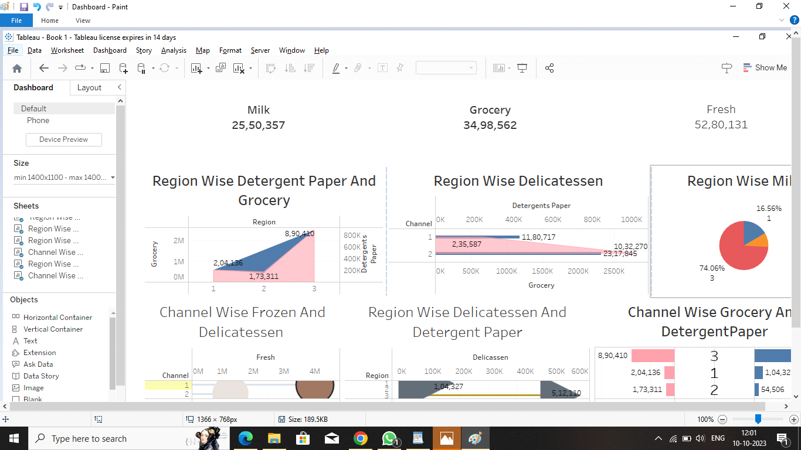
3.Result Dashboard:

Slide 5

Story:

Slide 6
4. Advantages:
In today's digitally-driven marketplace, businesses of all sizes increasingly recognize the importance of a strong online presence. Digital marketing has emerged as a powerful tool for reaching and engaging with target audiences, driving brand awareness, and boosting sales. However, despite the undeniable benefits, some business owners hesitate to invest significant sums in hiring digital marketers. Understanding the reasons behind this reluctance is crucial for marketers and business owners. In this article, we delve into the factors that may contribute to business owners' reluctance to pay high fees to digital marketers. From budget constraints to misconceptions about ROI, we explore the various elements that shape their decision-making processes. By gaining insight into these concerns, we can better navigate the landscape of digital marketing and foster productive collaborations between business owners and digital marketing professionals.
1.Small or medium-sized businesses often need more marketing budgets and may prioritize other expenses or marketing channels over digital marketing. They might perceive the cost of hiring a digital marketer as too high compared to their overall budget or expected return on investment.
2.Lack of understanding: Some business owners may need to understand the value and potential benefits of digital marketing fully. They might need to recognize the expertise and specialized abilities necessary to develop an efficient digital marketing strategy. This lack of understanding can make them hesitant to allocate significant funds to this area.
3.Previous bad experiences: Some business owners may have had negative experiences with digital marketers. If they saw satisfactory results or felt that they didn't receive a good return on their investment, they might be sceptical about spending more money on digital marketing services.

Slide 7
Disadvantages:
Advantages and Disadvantages of E-marketing
The digital age of the internet and the World Wide Web has transformed and computerized everything. The traditional marketing concept, strategies, and processes have shifted into e-marketing. Marketing over the internet or e-marketing involves more advanced and sophisticated tools. They provide easy access to the analytics and data, so the marketers could align their marketing and business strategies along with it. Now the question is what is e-marketing? Is it good or bad? Today, we’ll find all of these answers;
1.The point has already been made that the decision-maker should clearly communicate the purpose of the research to the marketing researcher but it is often the case that the objectives are not fully explained to the individual carrying out the study. Decision-makers seldom work out their objectives fully or, if they have, they are not willing to fully disclose them.
2.In situations, in which the researcher senses that the decision-maker is either unwilling or unable to fully articulate the objectives then he/she will have to pursue an indirect line of questioning. One approach is to take the problem statement supplied by the decision-maker and to break this down into key components and/or terms and to explore these with the decision-maker.
3.Whilst it is true that the purpose of research is to address some question, nonetheless one does not test research questions directly. For example, there may be interest in answering the question: "Does a person's level of education have any bearing upon whether or not he/she adopts new products?" Or, "Does a person's age bear any relation to brand loyalty behaviour?". Research questions are too broad to be directly testable.
5. Applications
This chapter begins by explaining the limitations of marketing research in so much that it serves to reduce rather than remove the risks attendant to decision making. The discussion proceeds to an outline of the research brief which has to be drawn up for the guidance of the individual or group charged with executing the study. At this point, the researcher has to respond to the brief with a research design. In this text an eight step research design is proposed and the reader will find a fairly thorough discussion of each of these steps within the chapter.
person 1
Since they do not have sufficient cash to pay for milling their rice they get paid in 'brokens'. The miller then sells the 'brokens' for animal feed.
person 2
The more effective milling machine simply did not fit into the Thai rice processing system. The company's assessment of the market was hardly objective.
person 3
They saw the 'brokens' as a problem which their product solved. The prospective customer did not see it as a problem at all.
person 4
· Define the role of marketing research in decision making
· Outline the contents of a research brief
6. conclusion:
There are essentially two approaches to establishing the resource allocation to a particular marketing research exercise. Management can start with the problem and work out how much it will cost to solve it. Alternatively, they can decide how much the management can afford to spend, at the time, and seek the best answer they can for the time, money and manpower allocated. In practice the decision-makers prefer the latter approach and the researchers the former. In the end, some kind of compromise develops. The researcher rarely gets all of what he/she judges is required to reach a satisfactory conclusion but if the research proposal is well thought out and persuasively presented some concessions can be obtained.
7. Future Scope:
Having received the research brief, the researcher responds with a research proposal. This is a document which develops after having given careful consideration to the contents of the research brief. The research proposal sets out the research design and the procedures to be followed. The eight steps are set out in figure 1.2. These are only briefly discussed here since the remainder of this textbook consists of a detailed explanation of each step.

